Slide 1

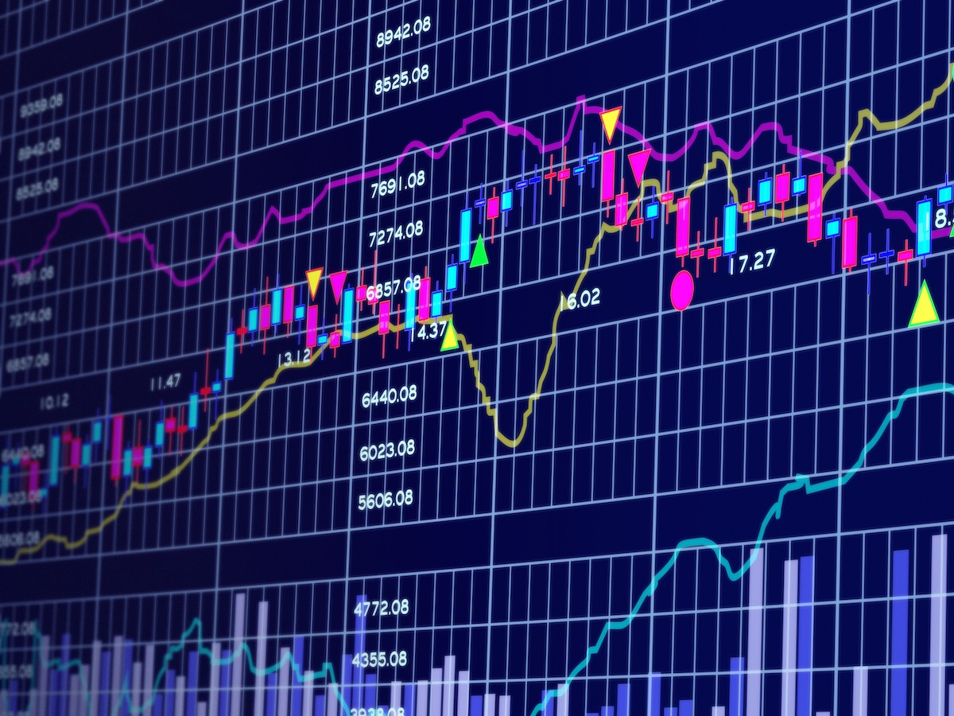

Capstone Project
Finance And Risk Analytics
By Vandana Dixit

Slide 2
Business Problem
Analyse a portfolio of stocks to provide consultation on investment management based on client’s requirement.
Provide consultation to two different investors, Mr. Patrick Jyenger and Mr. Peter Jyenger based on their requirements and financial objectives.
Mr. Peter Jayenger wants to maintain a decent standard of living post retirement. He is conservative investor and he wants to invest $500 k in equities with expectation doublings his capital with less risk in 5 yrs.
Mr. Peter Jayenger wants to invest $1 Million in most high margin stocks. He is consistent with his attitude towards risk and believes he can still bounce back in case of occasional losses.

Slide 3
Expectations:-
As a Portfolio Manager we have to suggest portfolio for Mr. Patrick Jyenger and Mr. Peter Jyenger for next five years keeping their motive of investment and nature of risk taking in mind.
For that Stock dataset over 10yrs:- from 1 Oct 2010 to 30 sept 2020 of 24 Stock of leading companies listed in NYSE.
You are expected to use technical analysis and required metric and active investment strategy to generate validate portfolio.

Slide 4
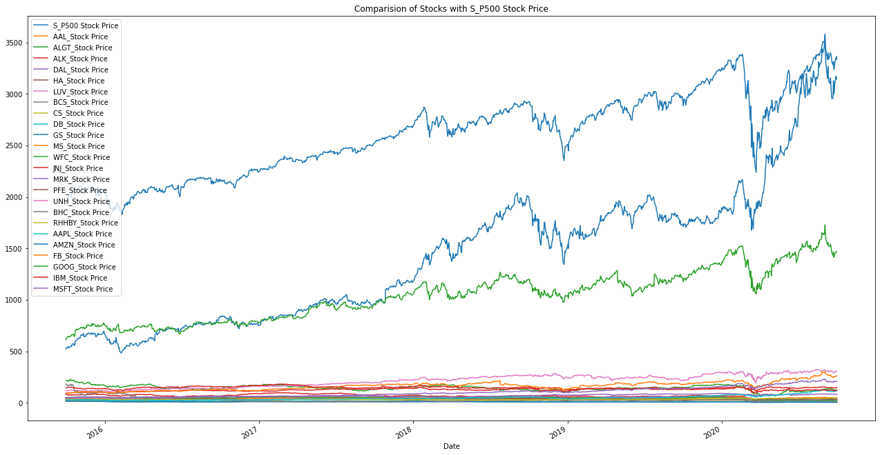
In Pandemic All Stocks Fall Down Except “AMZN Stock” And “GOOG Stock” Of Technology

Slide 5
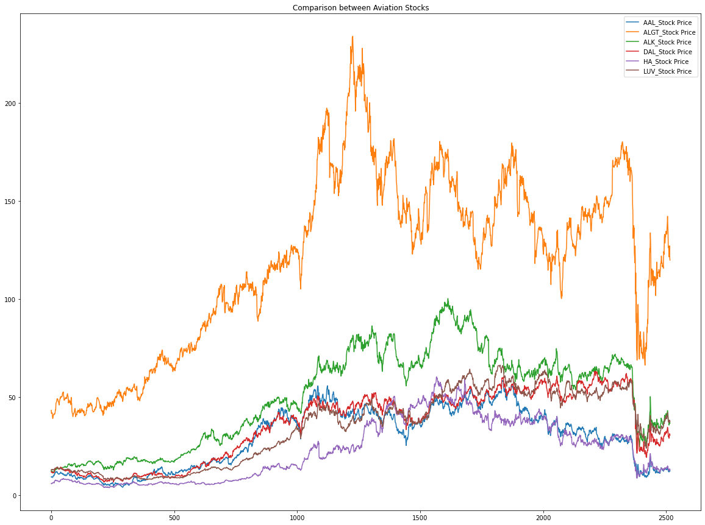


Aviation Stocks
Comparison Of All Stocks Of Aviation.
We Have Seen Positive Change In "ALGT Stock"
In Pandemic We Seen Fall In Other Stocks
We Have Seen Fall In "ALK Stock" Also But It's Not Fall As Much In Comparison Of Other Stocks.

Slide 6
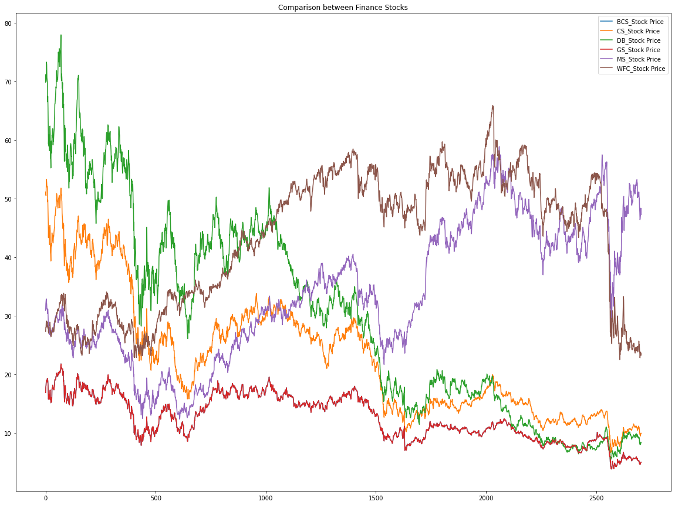
Comparison of All Stock of Finance. In Pandemic time every Stock fall down, but 'MS Stock' and 'WFC Stock' still manage to remain Positive.
Finance Stocks

Slide 7
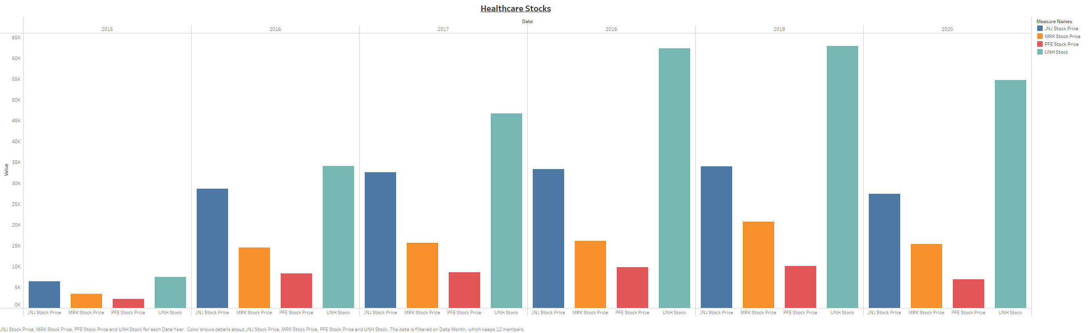
Comparison of all Stocks of Healthcare. In pandemic Healthcare sector not much effected in comparison to other sector. we have seen positive change.
Healthcare Stocks

Slide 8
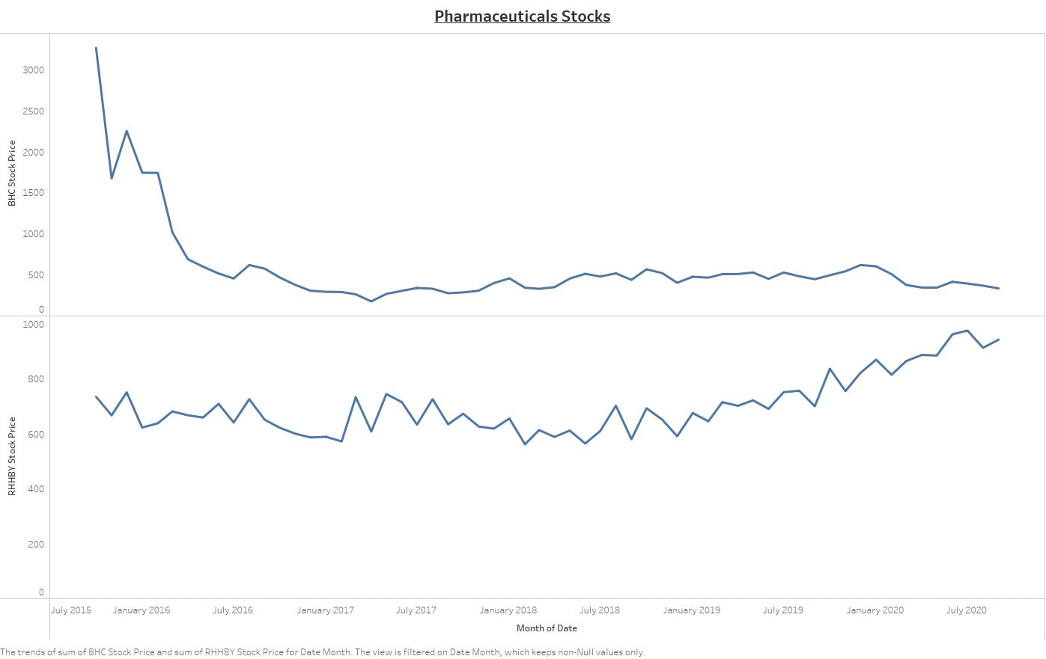
Comparison of Pharmaceutical Stocks. In Pandemic huge down fall in "BHC Stock", but on the other hand we have seen positive change in "RHHBY Stock".
Pharmaceuticals Stocks

Slide 9
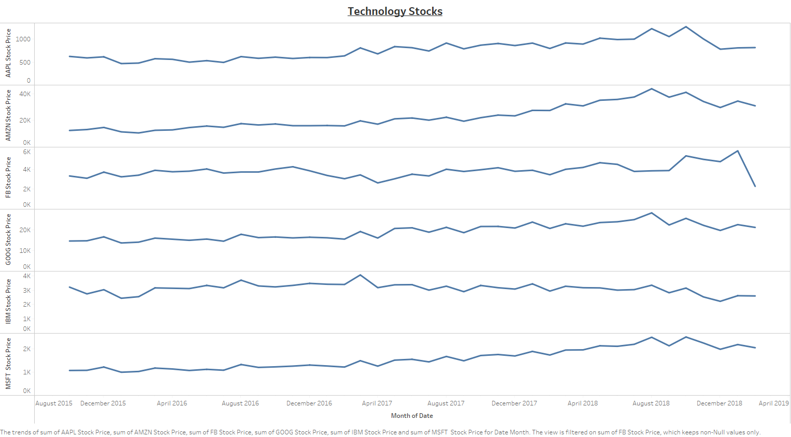
Comparison of all Stock of Technology. In Pandemic situation "GOOG_Stock" and "AMZN_Stock" are showing positive change, but rest of all stock showing constant.
Technology Stocks

Slide 10
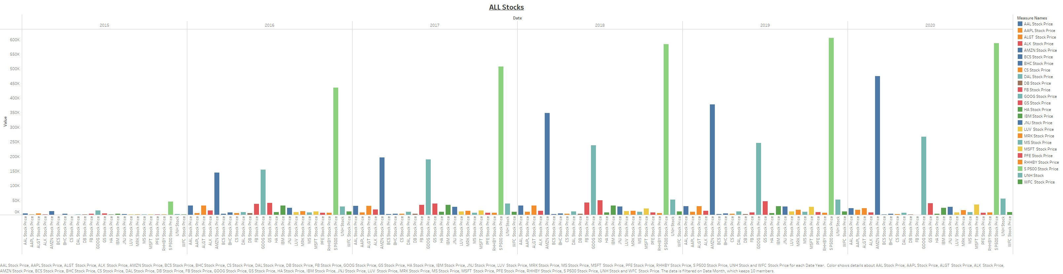
Comparison of All stocks of Industries. Positive growth in Technology Sector . In pandemic fall in every stocks. except "GOOGLE" and "Amazon" . ​
ALL Industries Group Stocks

Slide 11
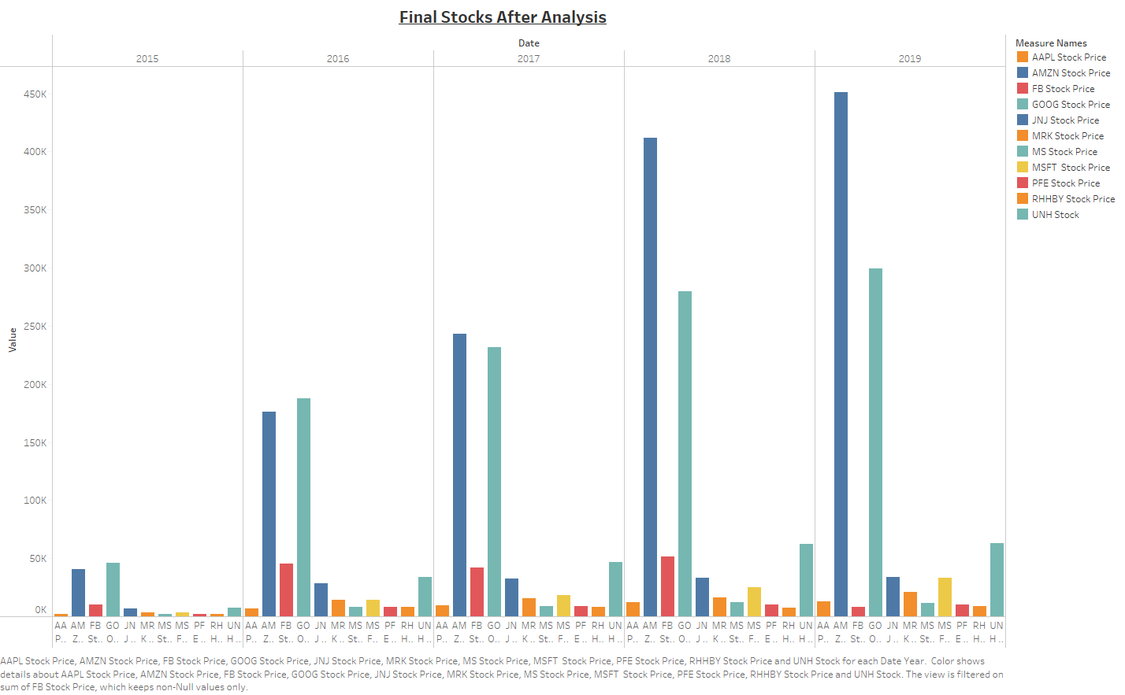
After Analysis, stocks which are showing Positive Annualized Returns.

Slide 12
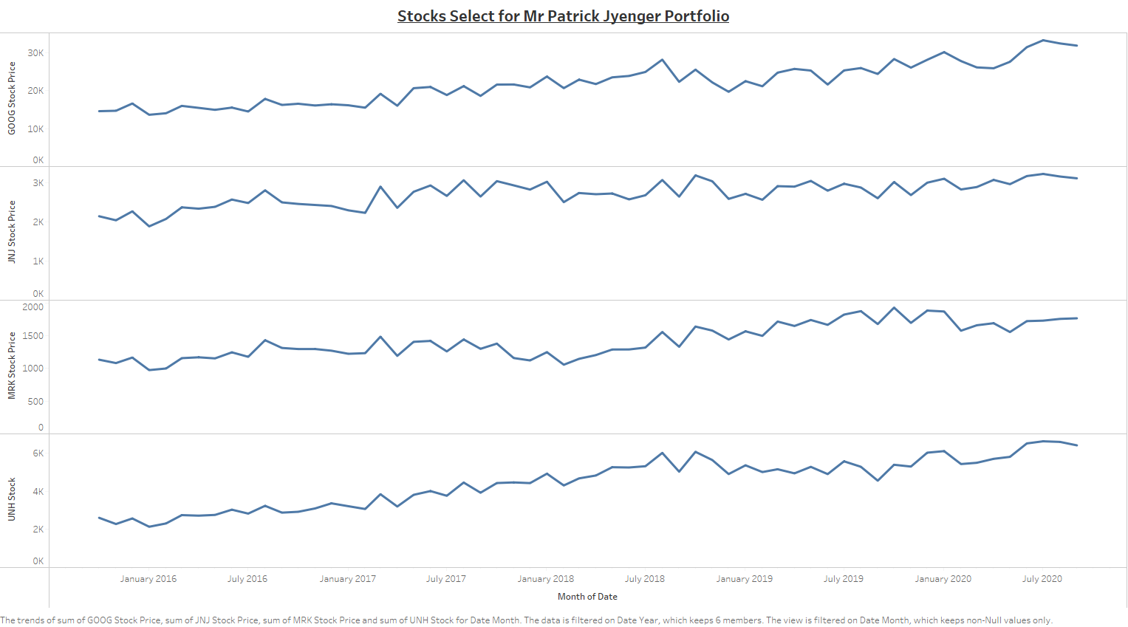
Mr. Patrick wants to Double his money with Minimum Risk. So, we choosed "JNJ_Stock" and "MRK_stock" , "GOOG_Stock" and "UNH_Stock”.

Slide 13
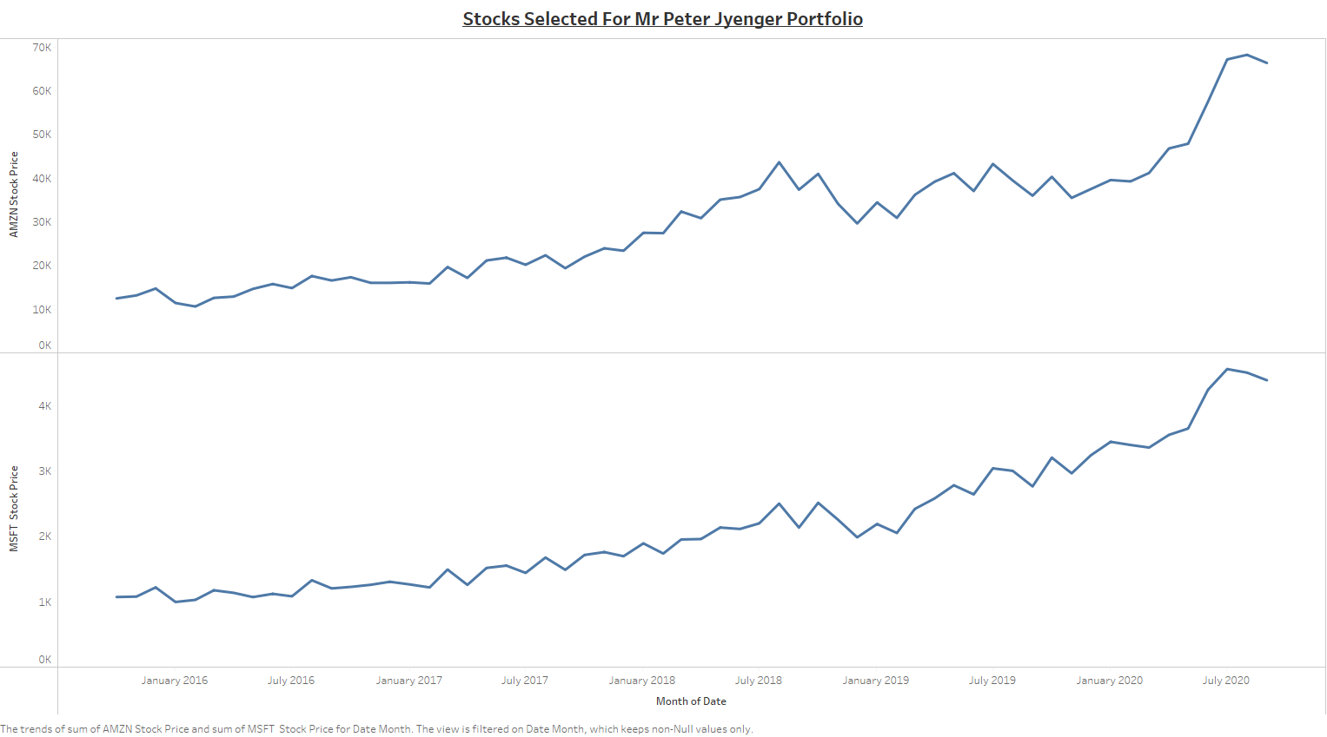

Mr. Peter wants Maximum Return on his Money and willing to take risk , so we chooses "AMZN_Stocks" and "MFST_Stock" for Mr. Peter Jyenger.

Slide 14
Thank You

